Slide 1
Architecture Proposal
Zhaolei

Slide 2
Assumptions of the customer
SaaS for Gas station management
Just got Pre A round funding from a traditional Gas company
They are interesting in AWS Activate Plan
Low operation and maintenance capability. High Dev capacity.
Busy with JAVA Spring cloud microservices
Runing LAMP stack on the IBM server within the machine room of their parent company

Slide 3
Requirements & problems
Security
Security of data at rest and in transit
Self-healing infrastructure that recovers from failed service instances
Securing access to the environment as the delivery team expands
Disaster recovery
Cost
Cost efficiency
Archival strategy for inactive objects greater than 6 months
Performance
Ability to configure database and data access layer for high performance and throughput
Making the user experience in the browser very low latency even though a large portion of their user base will be from far away
Effective distribution of load
Ability to easily manage and replicate multiple environments based on their blueprint architecture

Slide 4
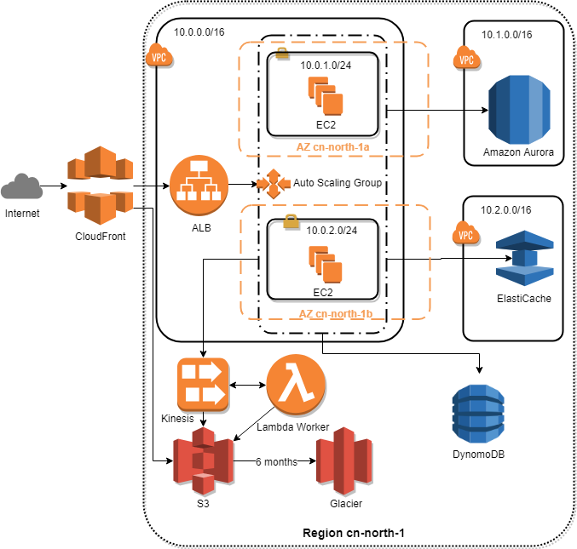
Architecture Proposal

Slide 5

Raise Goldfish, not sweat BMW
Notes:
Scaling to meet the demand, but with uncertainty around when and how much this demand will be
very concerned about buying too much infrastructure too soon or not enough too late
性价比 Save money in the long run
CIO选型 金鱼而不是汗血宝马

Slide 6
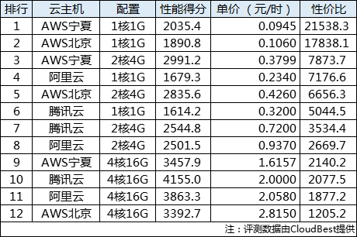
Reasonable price
http://cloud.idcquan.com/yjs/134551.shtml
Notes:
CIO价格选型的故事 横向扩展而不是向上扩展 一开始可以向上扩展，但是后来一定是横向扩展

Slide 7
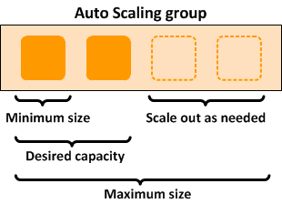
Save money in the long run by Auto Scaling
Notes:
Scaling uncertainty when and how much
Self-healing infrastructure that recovers from failed service instances
核心理念揽财
Save money
Easier for you to perform better
不同点：CloudWatch 命令行 CloudFormation
因为AWS有这个能力。几次创业都先用最便宜，最简单的机器。
甩手掌柜

Slide 8
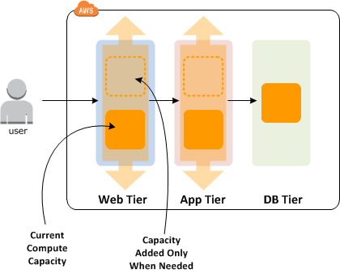
Save money in the long run at different tier
Notes:
甩手掌柜

Slide 9
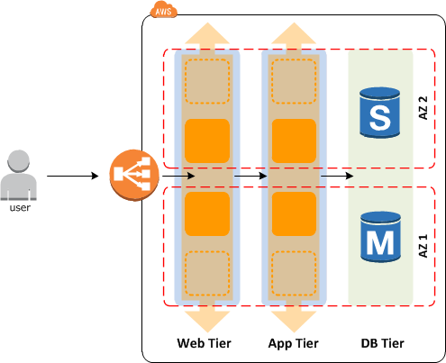
Disaster recovery by Availability zones
Availability zones — Two are used. If one availability zone (AZ) suffers from an outage, we still have EC2 instances running in the other AZ.
EC2 instances — We have multi-redundancy for EC2 instances. We have multiple instances in one subnet (AZ), and we have instances in two subnets (AZs).

Slide 10
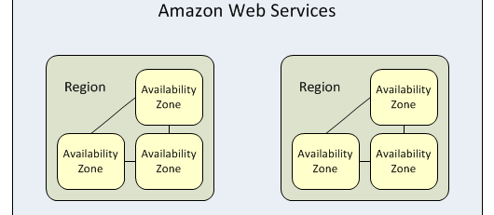
Don‘t put eggs in one basket – Region & Availability Zone
Notes:
Disaster recovery
Your strong support
Easier for you to perform better
北京，宁夏
鸡蛋不要放在一个篮子里

Slide 11
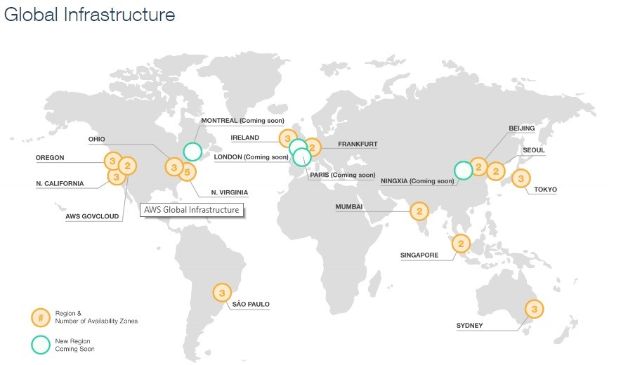
Notes:
Your strong support
Easier for you to perform better
全球客户触及

Slide 12






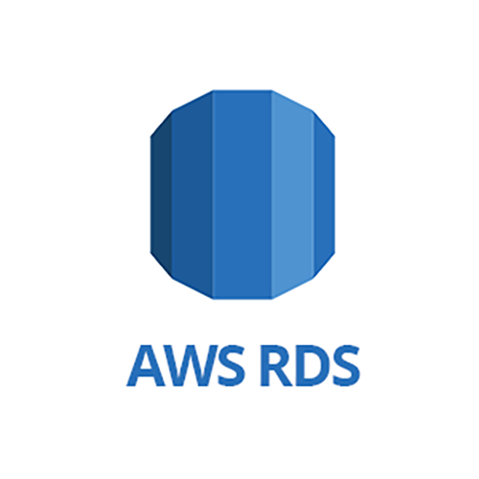






轻松管理
高度可扩展
可用且持久
快速
安全
便宜
Notes:
Database and data access layer for high performance and throughput
Security of data at rest
备份 计费和使用简单
Save money：不需要DBA
Easier for you to perform better：安基ERP项目，依赖外部谈判。后来不再焦虑不懂数据库运营，轻松备份。

Slide 13
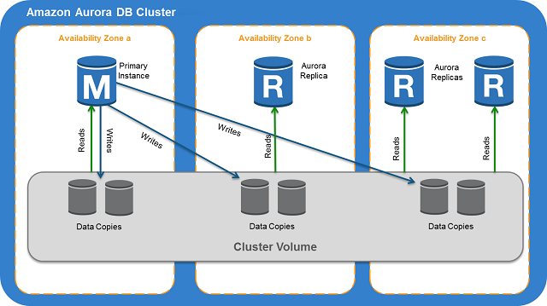
Notes:
Ability to configure database and data access layer for high performance and throughput Security of data at rest
备份 计费和使用简单
Save money
Easier for you to perform better
安基ERP项目，不再焦虑不懂数据库运营，依赖外部谈判，轻松备份。
不需要DBA

Slide 14
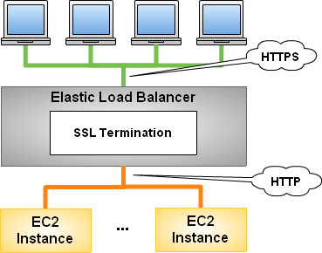
Security of data in transit using HTTPS
Notes:
ALB Security of data in transit
没有单台机的带宽限制
Easier for you to perform better
CIO故事：让AWS来操心HTTPS配置的问题，而不是找网管或者自己配置各种服务器

Slide 15
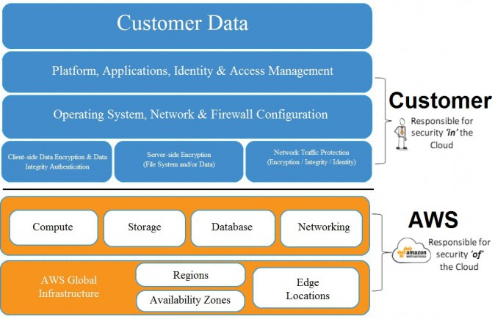
Amazon Web Services Security
Notes:
Security of data at rest
有名事件 vs 正直
Your strong support
不会被收集数据或者盗用

Slide 16
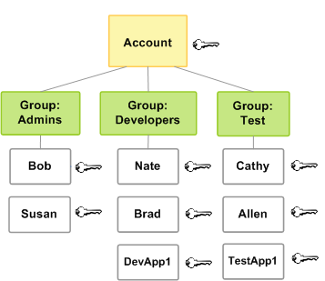
AWS Identity and Access Management (IAM)
Notes:
身份及访问管理
Securing access to the environment as the delivery team expands
CIO自己针对团队给予不同的组权限，不需要网管

Slide 17
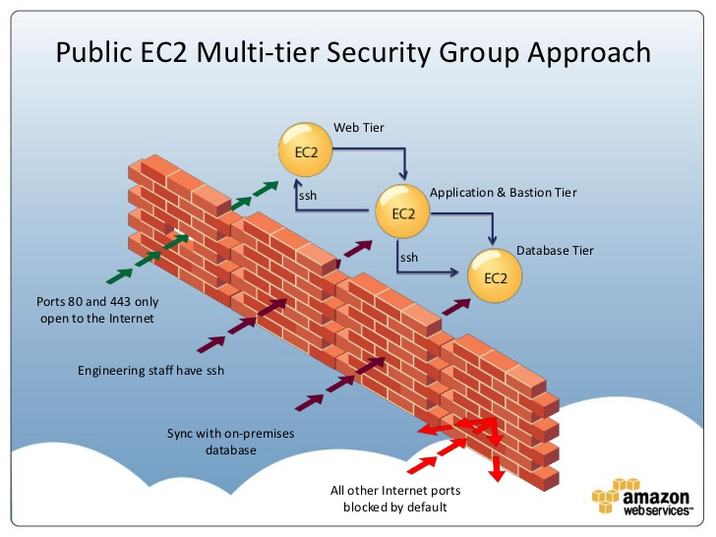
Protect your network with security groups
Network administrators are no longer needed
Notes:
Security of data at rest: 细粒度的权限

Slide 18
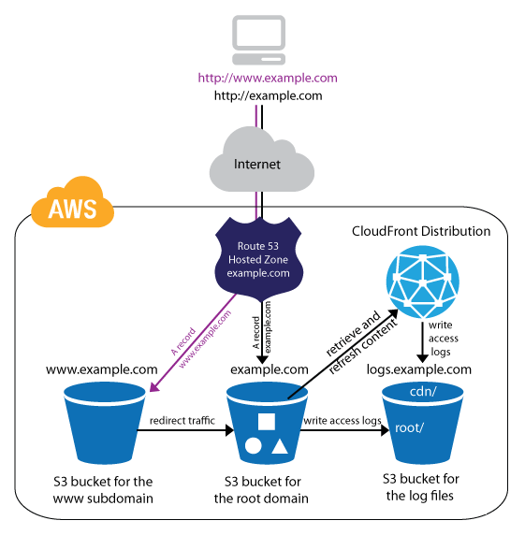
Use S3 & CloudFront to deliver the static web content
Notes:
Making the user experience in the browser very low latency even though a large portion of their user base will be from far away
Easier for you to perform better: 功能强大 metadata 自动化。
创业-自动化上线, SDK vs cli

Slide 19
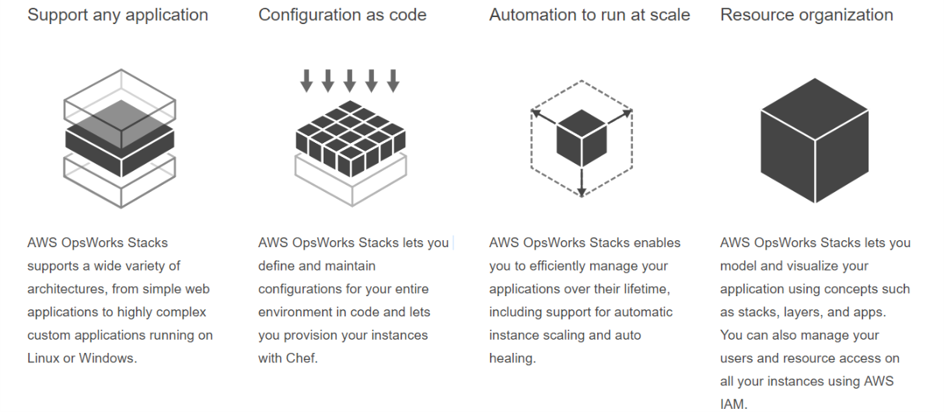
OpsWorks Stacks
Easily manage and replicate multiple environments based on your blueprint architecture
Notes:
Easier for you to perform better：友商在学习。图形化自动化运维应用。第一次用，惊叹，非常好用。

Slide 20
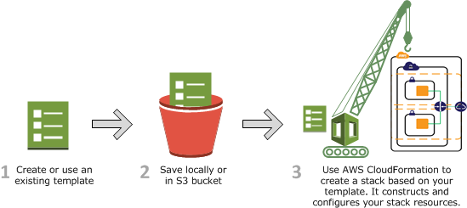
Easily manage and replicate multiple environments based on your blueprint architecture by CloudFormation
Notes:
Ability to easily manage and replicate multiple environments based on their blueprint architecture
友商没有
Easier for you to perform better
强大的自动化运维应用
第一次用，复杂，全面覆盖

Slide 21
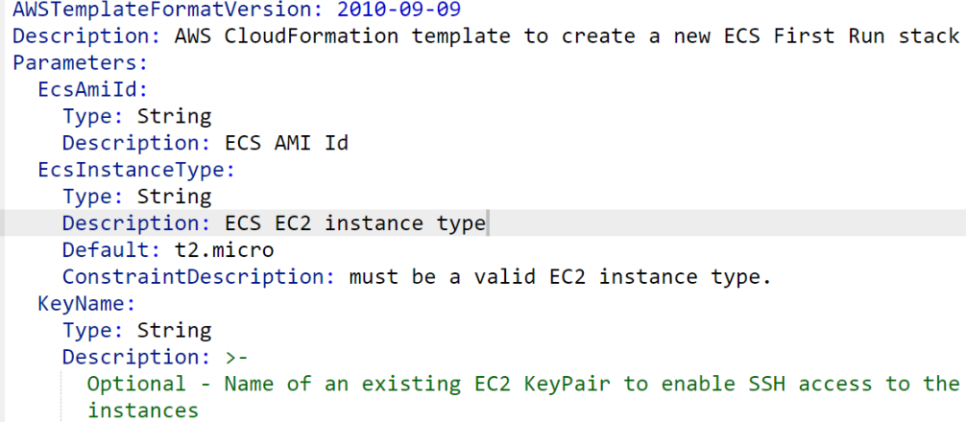
Easily manage and replicate multiple environments based on your blueprint architecture by CloudFormation

Slide 22
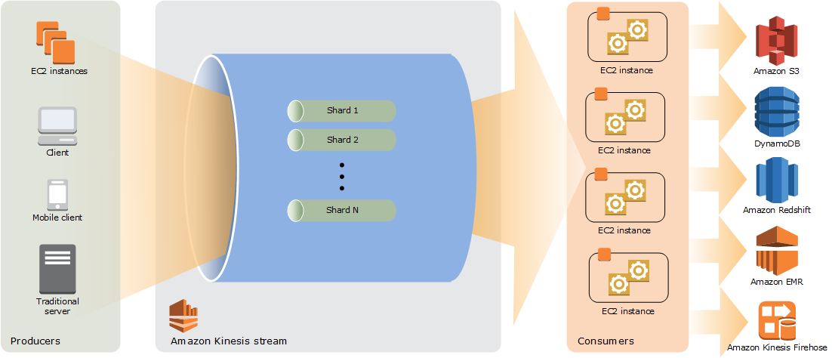
Effective distribution of load asynchronously by Kinesis
Notes:
Kinesis
Effective distribution of load
计费
对手标准Kafka，但是内测，不好控制, Zookeeper
Easier for you to perform better自己开发的
第一次用非常简单 vs kafka非常麻烦，需要太多决策

Slide 23
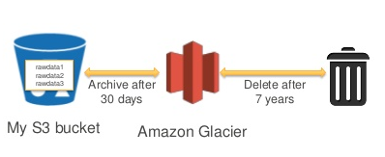
Data stored in S3 can be configured by a lifecycle rule to move objects to Glacier automatically
Notes:
S3, Glacier
Archival strategy for inactive objects greater than 6 months
后付费便宜，预付费
Easier for you to perform better
CIO
不需要存水，自来水

Slide 24
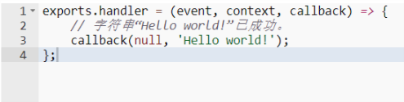
Serverless by lambda
Notes:
Effective distribution of load Scaling to meet the demand, but with uncertainty around when and how much this demand will be they are very concerned about buying too much infrastructure too soon or not enough too late
发明者 SAM
Easier for you to perform better

Slide 25


ElastiCache & DynamoDB
Notes:
ElastiCache 无状态X Scaling部署简单Easier for you to perform better 折腾 vs 不折腾
DynamoDB mongodb。即开即用Easier for you to perform better事件记录；快速启动。

Slide 26
Just remember that AWS Help you
Save money in the long run
Easier to perform better
Your strong support

